Slide 1

Unit 4

Slide 2
Recognize the importance of AI
Notes:
Version: 1.1

Slide 3

Voice of the Future
How will a voice assistant evolve in 25 years from now?
Notes:
Facilitator Guide
Type of screen: Activity
Recommended Duration: 90 mins
Aim and objective of this screen: Initiate a discussion and activity around the future of Voice Assistants.
Do:
Divide the class into groups.
Share examples of voice assistants which they see in their everyday lives (Siri, Alexa, Google Assistant, etc)
Ask: What else do you want the voice assistant to do for you?
Say:
Today we will participate in a group activity
We just spoke about AI and voice assistants.
In this activity you will share your vision about the future of voice assistants.
All you need to do is prepare a 3 min video or audio piece on “How will a voice assistant evolve in 25 years from now?”
You will first create a script and talk about your vision in this class. Later you will develop the video/audio piece and post it on the BCVS facebook page. Use the Video Editor app to edit, trim, add title, sound, effects and apply titles.

Slide 4
AI in Everyday Life
Notes:
Version: 1.1

Slide 5
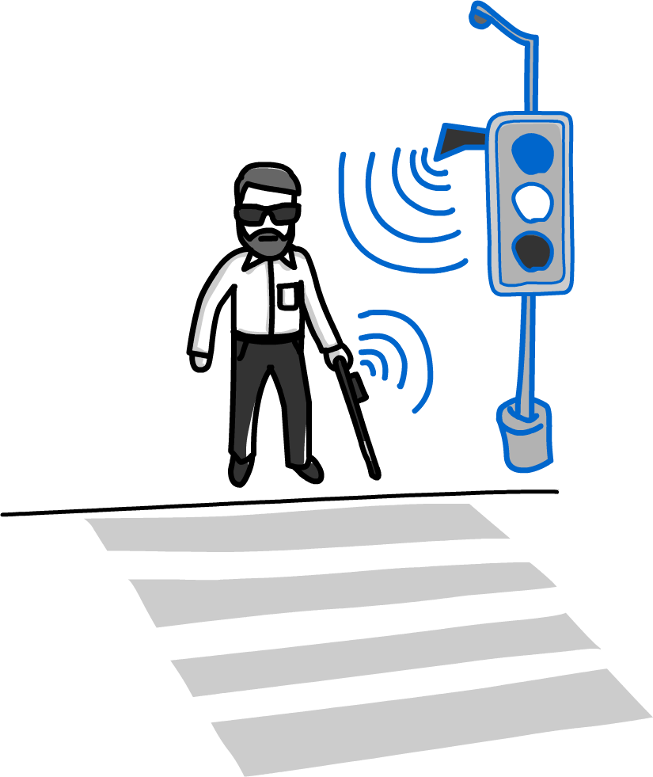
AI in Everyday Life
Showtime!
Lets watch a video in youtube!
Most AMAZING Examples Of Artificial Intelligence (AI)
Notes:
Facilitator Guide
Type of screen: Lab
Recommended Duration: 90 min
Aim and objective of this screen: This slide sets the context for a discussion on how AI has become a part of our everyday life.
Say: Let us now watch a video in youtube Most AMAZING Examples Of Artificial Intelligence (AI) which beautifully shows how AI is part of our every day life. This video describes how Hal 9000,Tesla Car, Cortana, Pandora Skynet etc have changed human lives.
Do: Initiate an open house discussion on what they saw and heard.
Involve all students in the discussion. Encourage them to take part in the discussion and contribute their observations.
Divide them in groups and ask them to come up with a role play to demonstrate their vision and understanding of the topic.
Do: Suggest the following for viewing and reading
1. Ted talks Artificial Intelligence play list (use the app)
2. The rise of AI Bloomberg
3. I, Robot- movie or any other book
4. IQVIS- blog/9-powerful-examples-of-artificial-intelligence-in-use-today
.

Slide 6
Suggestions for viewing and reading
1. Ted talks Artificial Intelligence play list (use the app)
2. The rise of AI Bloomberg
3. I, Robot- movie or any other book
4. IQVIS- blog/9-powerful-examples-of-artificial-intelligence-in-use-today

Slide 7
Communicating with machines
Notes:
Version: 1.1

Slide 8

Befriend
Play the youtube video-
We Talked To Sophia – The AI Robot That Once Said It Would ‘Destroy Humans”
Let’s watch Sophia and discuss what we heard and felt.
Notes:
Facilitator Guide
Type of screen: Discussion/Lecture
Recommended Duration: 60 mins
Aim and objective of this screen: Initiate thoughts and discussions on how we can communicate with machines in future work place. How humans and their digital creations can complement each other.
Do: Play the video We Talked To Sophia – The AI Robot That Once Said It Would ‘Destroy Humans”
At the end of the video, initiate an open house to discuss what did the students hear, see and felt. How would they bring in the human element in machine interacting.( Hint: Guide the response towards Sophia’s lack of empathy, eye contact etc)
Say:
How do we communicate with our friends?
How many times do we talk face to face with our friends and family members?
In which mode are you more comfortable? Face to face/texting/video calls/voice messages/social platforms.
What are the ways in which we communicate with machines?
Are you comfortable in this way?
How do you imagine that it will change? (Hint: About 30 years ago we communicated with bank tellers but now we communicate with ATMs or even banking Apps.)
Say:
We will end the session with the question: How will offices/workplaces change in future? Who do you think would be your colleagues?
Next day we will have a debate in the presence of an external moderator on topics related to AI.
Do: Request the group to refer to the article “The future of human communication: How artificial intelligence will transform the way we communicate” by Noah Zandan while preparing for the debate. They can of course refer other sources on the internet. Suggested reading-Search Google and access an article named “How robots and humans can get along” by Nancy Cooke – Fast company.

Slide 9
Prep for a Debate
Suggested Reading from Google :
Future of AI is Biological-Towards Data Science, Benefits & Risks of AI, What’s next for AI –Conversation with context-IBM
Watch Elon Musk and Yuval Noah Harari in youtube
Notes:
Facilitator Guide
Type of screen: Discussion
Recommended Duration: 5 mins
Aim and objective of this screen: Inform the students about a class debate which will take place shortly. Share suggested prep material for the debate.
Say: In one of the next classes you will have to participate in a debate. You need to prepare well for the debate. I am sharing some suggested research and reading material but you should try and gather more information on related topics.

Slide 10
AI in Future
Visualise a college in the year 2050
Notes:
Version: 1.1

Slide 11
TECHNICAL WRITING PROCESS- RECAP-1
Define Requirements
Focus on the users
Analyze the audience
Map & Plan your document
Understand the user
Consult with experts
Notes:
Facilitator Guide
Type of screen: Lecture/discussion>Technical Writing
Recommended Duration: 5 mins
Aim and objective of this screen: (((This slide shows the steps involved in technical writing)))
Do: The professors to take them through the technical writing process(( step by step )) . Give examples wherever necessary.
Say: Understand the purpose: ((In the next few slides we will learn what are the key points we need to remember while writing a document which is technical in nature. ))
Say: ((As we discuss each step you will look into your write up and make the necessary changes. You can note down your questions, if any we will deal with them after the discussion.))
Elicit: The participants’ response to the activity. Check if they have any questions about the activity.
Additional information: Continuation to the next slide

Slide 12
TECHNICAL WRITING PROCESS- RECAP-2
Define Requirements
The first step of writing a document is to understand the purpose. The writer needs to ask questions to understand the purpose of creating the document.
Audience is the intended reader/user. Generally technical information is complex and difficult to interpret by a layman so it is critical to analyze the audience.
Analyze audience
Notes:
Facilitator Guide
Type of screen: Lecture/discussion>Technical Writing
Recommended Duration: 10 mins
Aim and objective of this screen: This slide provides details about technical writing characteristics for the students.
Do: The professors to take them through each pointer in detail along with examples:
Say: Define Requirements- The first step of writing a document is to understand the purpose. The writer needs to ask questions to understand the purpose of creating the document.
Example: You are building a software and each step is clearly defined starting from the medium where you will be writing the codes to publishing.
Analyze audience: Your audience is your intended reader, or who you’re writing for. In technical writing, your audience is often going to fit into one of the following categories:
Executives—Those who are funding the product
Experts—Those who are coming up with ideas about the product
Technicians—Those who are building the product
Non-specialists—The end-user

Slide 13
TECHNICAL WRITING PROCESS- RECAP-3
Understand the user
The audience will have their own expectations and needs. It’s important for you to understand what the readers are looking for. The document should answer their questions and needs.
Once the writer understands the user, he has to focus on how the document will cater to the needs of the audience. A good practice is to create a document that compiles information points simply in an easy step by step manner.
Focus on the user
Notes:
Facilitator Guide
Type of screen: Lecture/discussion>Technical Writing
Recommended Duration: 10 mins
Aim and objective of this screen: This slide provides details about technical writing characteristics for the students.
Do: The professors to take them through each pointer in detail along with examples:
Understand the user: The audience will have their own expectations and needs. It’s important for you to determine what the reader is looking for. The document should answer their needs and questions. While writing often we overlook the users and communicate from our own perspective and comprehension. You need to ask the following questions: Who are they?
What do they need?
Where will they be reading?
When will they be reading?
Why will they be reading?
How will they be reading?
Example: Let’s say if we are writing a technical proposal for a pilot R&D program to control home heating from a smartphone. Your audience might be a marketing professional who is working on the marketing campaign of the product. In order to properly prepare the technical proposal, it is important to know the layman’s (I this case the marketing professionals) knowledge of the research area. It would be crucial to know the products unique features that are user friendly and how they are an edge over the competing brands.
User experience : Now that we know the audience and their needs, let’s focus on how the document itself caters to their needs. Once you understand the user, he has to focus on how the document will cater to the needs of the audience. A good practice is to create a document that compiles information points simply in an easy step by step manner.

Slide 14
TECHNICAL WRITING PROCESS- RECAP-4
You need a style guide and documentation plan. The document should have a uniform style throughout in terms of word length, sentence length, frequency of word usage, etc.
Mapping & Planning your document
Make sure you consult a specialist or subject matter expert to get additional or parallel information that makes the information more useful to the end user.
Consulting with experts
Notes:
Facilitator Guide
Type of screen: Lecture/discussion>Technical Writing
Recommended Duration: 10 mins
Aim and objective of this screen: This slide provides details about technical writing characteristics for the students.
Do: The professors to take them through each pointer in detail along with examples.
Map & Plan your document: You need a style guide and documentation plan. The document should have a uniform style throughout in terms of word length, sentence length, frequency of word usage, etc.
Consulting with experts: Make sure you consult a specialist or subject matter expert to get additional or parallel information that makes the information more useful to the end user.
Example: When you are creating a document try and meet the subject matter expert at the very beginning of the project to get feedback & accordingly incorporate those inputs.
Elicit: The participants’ response to the activity. Check if they have any questions about the activity.
Additional information: Continuation to the next slide

